Slide 1
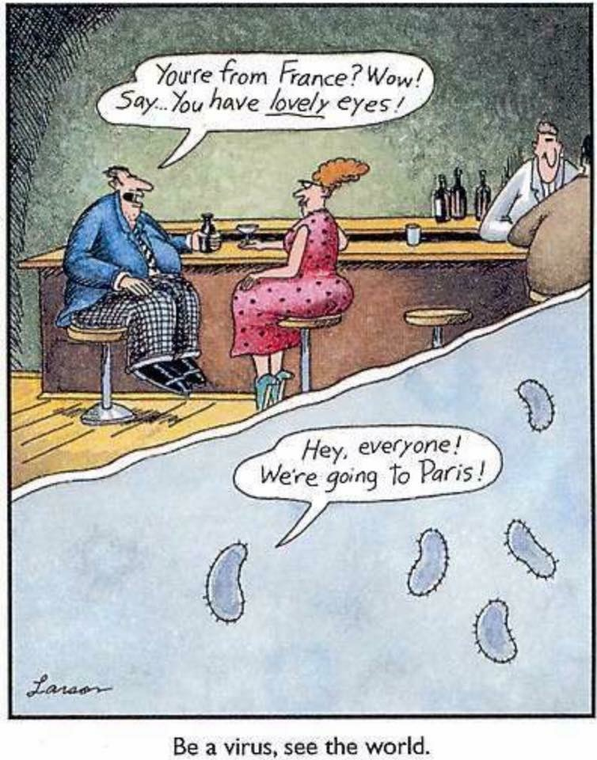
Syphilis then, now, and into the future!
Dr. Richard Rusk
Medical Officer of Health, Manitoba Health
Department of Community Health Sciences and
Department of Emergency Medicine
University of Manitoba
November 2018
Notes:
Pierre

Slide 2
Faculty/Presenter Disclosure
Faculty: Richard Rusk
Relationships with commercial interests:
  Grants/Research Support: “I wish”
  Speakers Bureau/Honoraria: “I wish”
  Consulting Fees: “I wish”
  Other (s.a. major shareholder): “I wish”
This presentation has received no commercial support
Acknowledgements: Dr Pierre Plourde
Notes:
This slide must be visually presented to the audience AND verbalized by the speaker.

Slide 3
Syphilis - Objectives
Review the clinical manifestations, diagnostic testing, and treatment of syphilis
Describe the evolving social epidemiology of syphilis in Manitoba
Discuss syphilis outbreak response strategies, and the significant challenges into the future
Address potential new IP&C risks

Slide 4
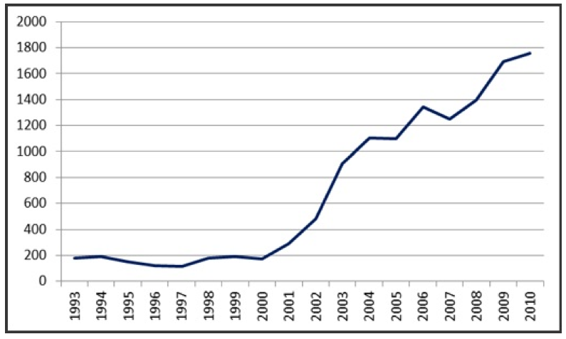
Background - Canada
Since 2000, there have been outbreaks of infectious syphilis reported in Vancouver, Calgary, Edmonton, Toronto, Ottawa, Montreal, Halifax …
Vancouver - MSM
Calgary - MSM/Hetero
Edmonton – MSM/Hetero
Toronto - MSM
Ottawa - MSM
Montreal - MSM
Halifax - MSM
Notes:
Pierre

Slide 5
Background - Winnipeg
Until January 2003, the incidence of syphilis infection (imported cases) had remained stable at less than 1 case per 100,000 population
No locally acquired infectious syphilis since 1995
Notes:
Pierre

Slide 6
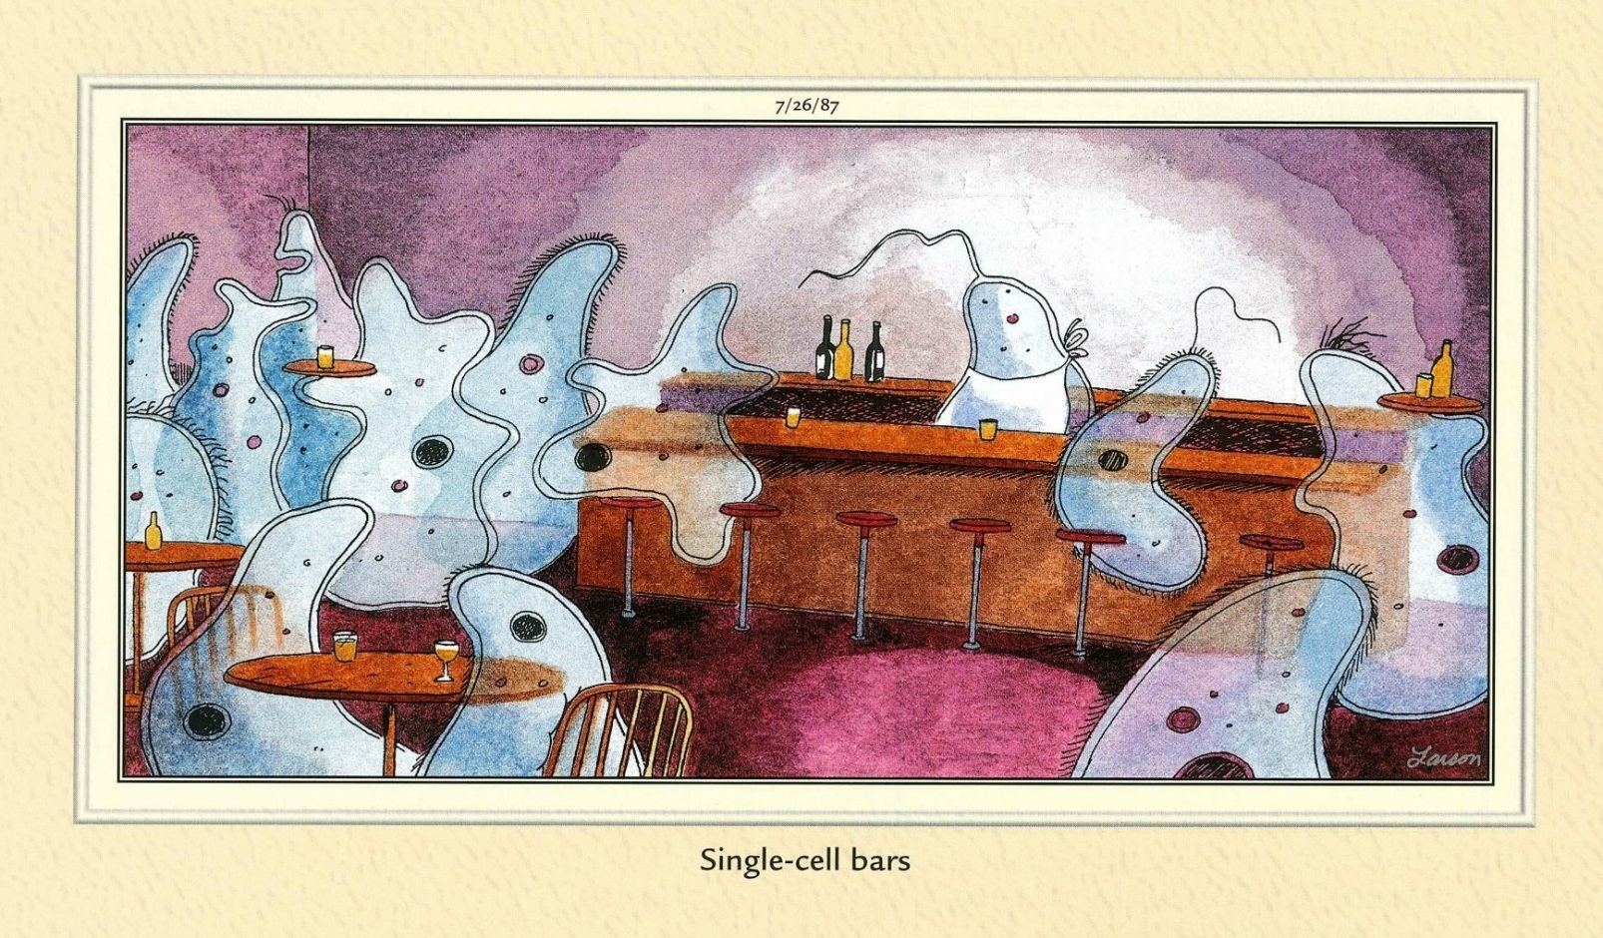
Syphilis – the Basics
  Re-emerging disease (since 2000)
  Treponema pallidum, spp. pallidum
Notes:
Pierre

Slide 7
Syphilis – the Basics
  Direct (sexual) contact; blood transfusion; congenital
  Incubation Period: 10-90 days
  Stages – primary, secondary, early latent, late latent, and tertiary
Notes:
Pierre

Slide 8
Infectious Syphilis
  Primary – Ulcers (chancres) on penis/vagina
  Secondary – Rash (any kind except vesicular); may be on palms of hands or soles of feet; systemic illness
  Early Latent – Asymptomatic (12 months)
Notes:
Pierre

Slide 9

Serology – Testing Algorithm
Treponemal Test
(CMIA)
chemiluminescent microparticle immunoassay
No current or previous treponemal infection
Non-reactive
Reactive
Non Treponemal Test
(VDRL/RPR)
RPR +
TPPA +
RPR -
TPPA +
RPR +
TPPA -
RPR -
TPPA -
Most likely diagnosis
Active
treponemal infection
Old treated treponemal infection
Biologic false positive
False positive
Other diagnoses
Treated after many years of infection
Latent active
treponemal infection
Early active
treponemal infection
Early active
treponemal infection
Can J Infect Dis Med Microbiol 2015;26 (Supp A)
Notes:
Joss

Slide 10
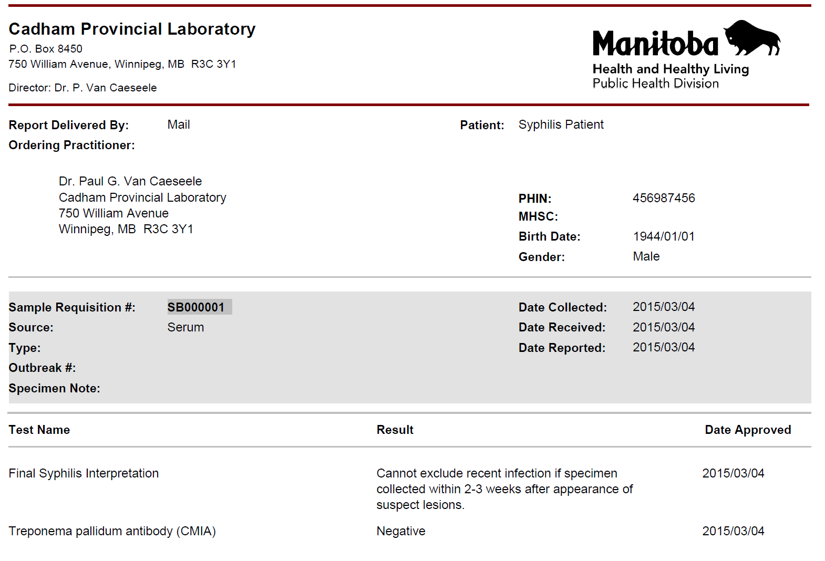
No Syphilis (Probably)
Notes:
Joss

Slide 11
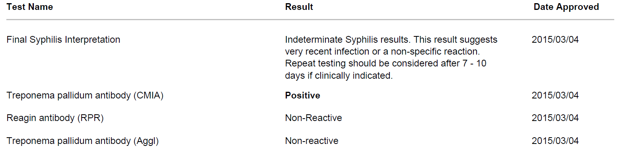
No Syphilis? Early Syphilis?
Notes:
Joss

Slide 12
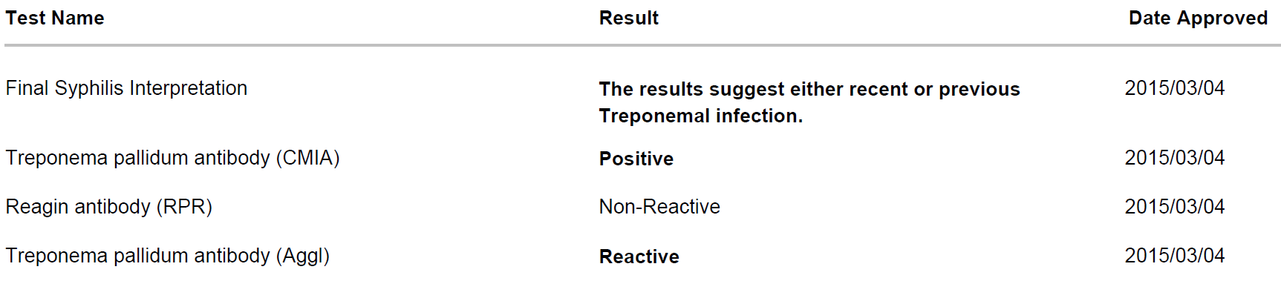
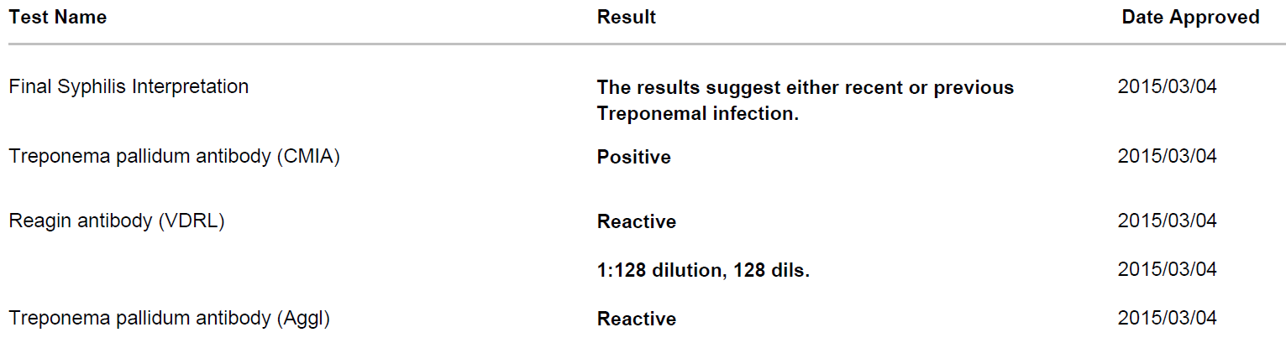
Syphilis Infection (Probably)
Notes:
Joss

Slide 13
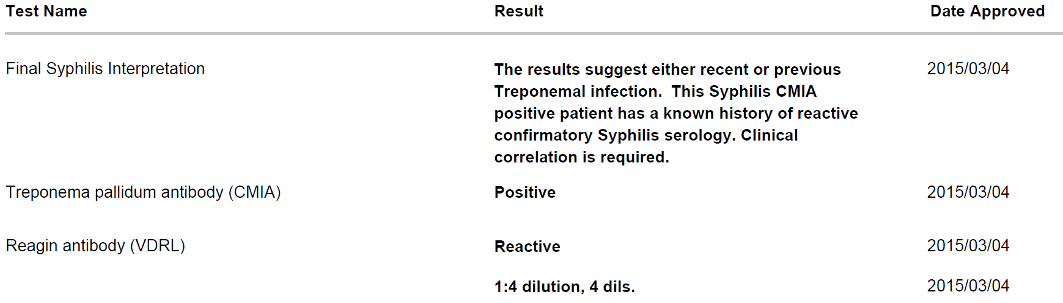
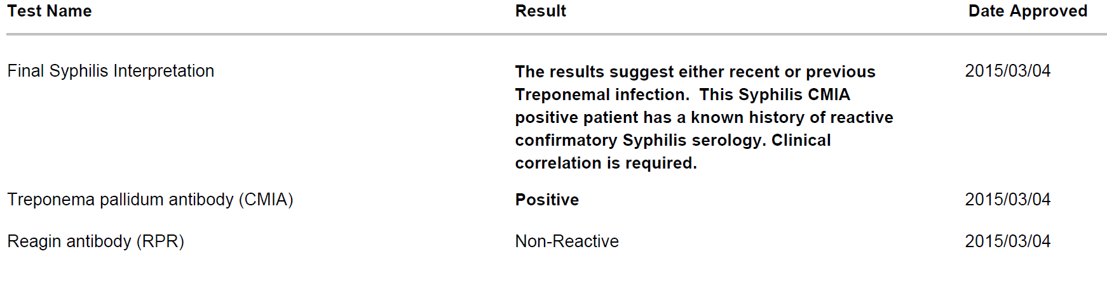
Known Previous Syphilis
Notes:
Joss

Slide 14

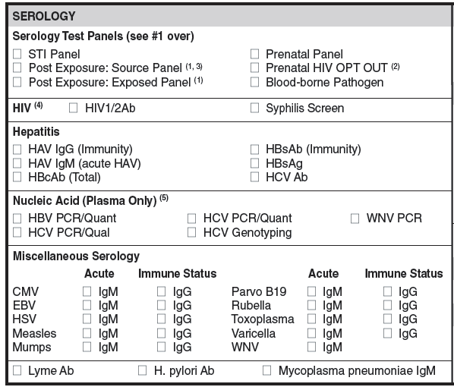
Ordering serology
STI Panel = HBsAg, HBsAb, HIV Ab, syphilis Ab
Prenatal Panel = HBsAg, Rubella IgG, syphilis Ab, HIV Ab
Blood-borne Pathogen = HIV Ab, HBsAg, HCV Ab
Notes:
STI Panel = HBsAg, HBsAb, HIV, syphilis
Prenatal Panel = HBsAg, Rubella IgG, syphilis, HIV
Blood-borne Pathogen = HIV, HBsAg, HCV

Slide 15
How to treat?
Notes:
Pierre

Slide 16
How to get Bicillin®?
Benzathine penicillin G (Bicillin®) 2.4 million units IM in a single session (separated into 2 injections)
Bicillin® in preloaded syringes provided free of charge by Manitoba Health
Can only be obtained by faxing a completed Manitoba Health STD Medication Administration Form (call Materials Distribution Agency at
945-0570 or download form:
http://www.gov.mb.ca/health/publichealth/cdc/protocol/form11.pdf
Notes:
Pierre

Slide 17
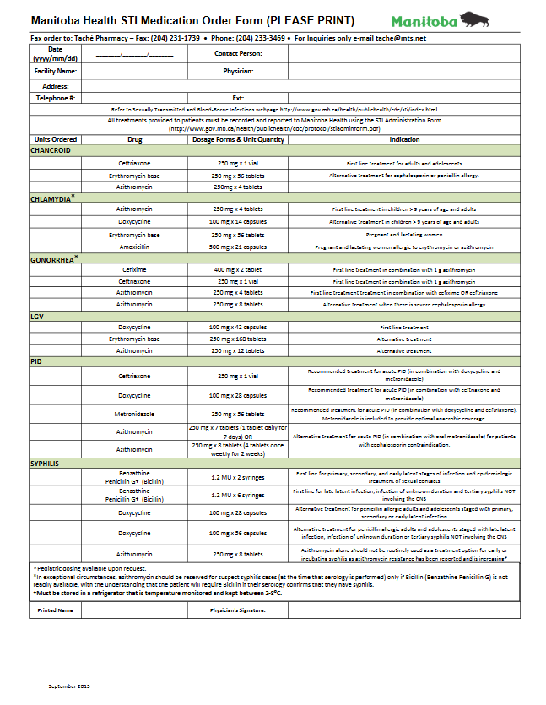
https://www.gov.mb.ca/health/publichealth/cdc/sti/index.html

Slide 18
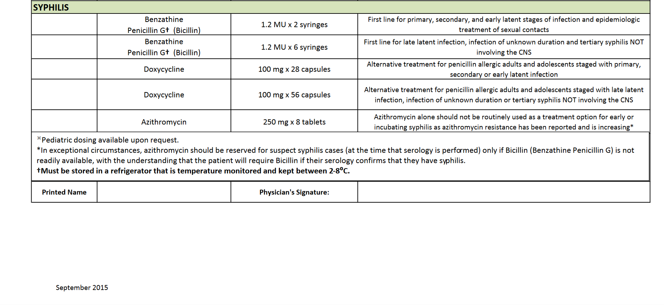
http://www.gov.mb.ca/health/publichealth/cdc/protocol/form11.pdf

Slide 19
Infectious Syphilis Cases - WHR
N=238
Source: Syphilis Surveillance Database, Population and Public Health Program, Winnipeg Regional Health Authority, June 2013
Notes:
Pierre

Slide 20
Outbreak Demographics
Predominant risk factors
January 2003 to December 2005 (2007 cluster)
  place of meeting at inner city bars
  significant alcohol use
  casual unprotected sex (male-female)
  no link to sex trade work
  numerous sexual networks ranging in size from 2 to more than 15 individuals
Notes:
Pierre

Slide 21
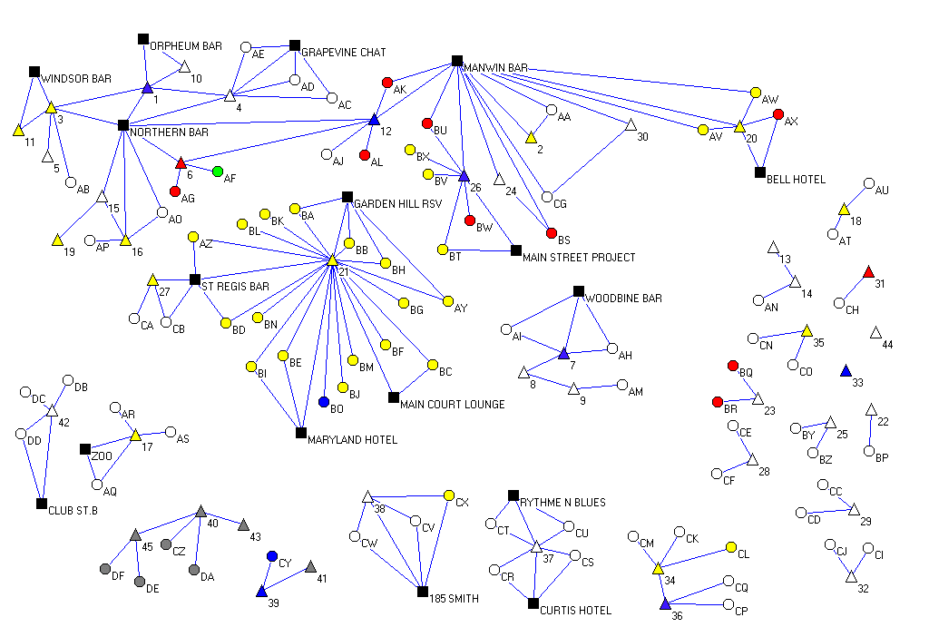
Mental Health Sex Trade Mental Health + Sex Trade Alcohol Abuse Mental Health + Alcohol Use MSM
Notes:
Pierre

Slide 22
Infectious Syphilis Cases - WHR
N=238
Source: Syphilis Surveillance Database, Population and Public Health Program, Winnipeg Regional Health Authority, June 2013
Notes:
Pierre

Slide 23
Outbreak Demographics
Predominant risk factors
December 2003 to January 2009
  exclusively MSM
  frequenting MSM-specific meeting places
  anonymous unprotected sex (male-male)
40-50% HIV +
Notes:
Pierre

Slide 24
Infectious Syphilis Cases – WHR*
N=592
Source: Syphilis Surveillance Database, Population and Public Health Program, Winnipeg Regional Health Authority, October 2017
*Has postal code in WHR or is identified as resident in WHR; excludes cases not resident in Winnipeg

Slide 25
Infectious Syphilis Cases – WHR*
N=908
Source: Syphilis Surveillance Database, Population and Public Health Program, Winnipeg Regional Health Authority, October 2018
*Has postal code in WHR or is identified as resident in WHR; excludes cases not resident in Winnipeg

Slide 26
Demographics (WHR* cases 2013-17)
>590 Infectious Cases (since 2013)
80% male (59% of men MSM + 17% of men bisexual)
Downtown (33%), Point Douglas (14%), and River Heights (9%)
  86% “locally acquired” (9% “imported”)
*Has postal code in WHR or is identified as WHR resident

Slide 27
Demographics (WHR* cases 2013-17)
38% “meeting” on social media
18% HIV (?resistant) – although much lower recently – 9% in 2016
71% primary/secondary
78% 20-49 yo
*Has postal code in WHR or is identified as WHR resident

Slide 28
Outbreak summary
Predominant risk factors
  September 2012 to October 2017
    mostly MSM/MSMW
    meeting online or via mobile phone apps
    anonymous unprotected sex (male-male)
    increasing heterosexual transmission (?bisexual bridges, sex trade)
  Less than 10% are HIV + (all male)
Notes:
Joss

Slide 29

Outbreak summary
Predominant risk factors
  September 2012 to October 2018
    Earlier on in epidemic: mostly MSM/MSMW
      meeting online or via mobile phone apps
      anonymous unprotected sex (male-male)
    BUT 2017 onwards, predominantly heterosexual transmission (sex trade, crystal meth, incarceration, structurally disadvantaged)
      In 2018, 24% report IDU w/ meth
        22% currently incarcerated
  IN 2018 8% are HIV + (incl. male & female)
Notes:
Joss

Slide 30
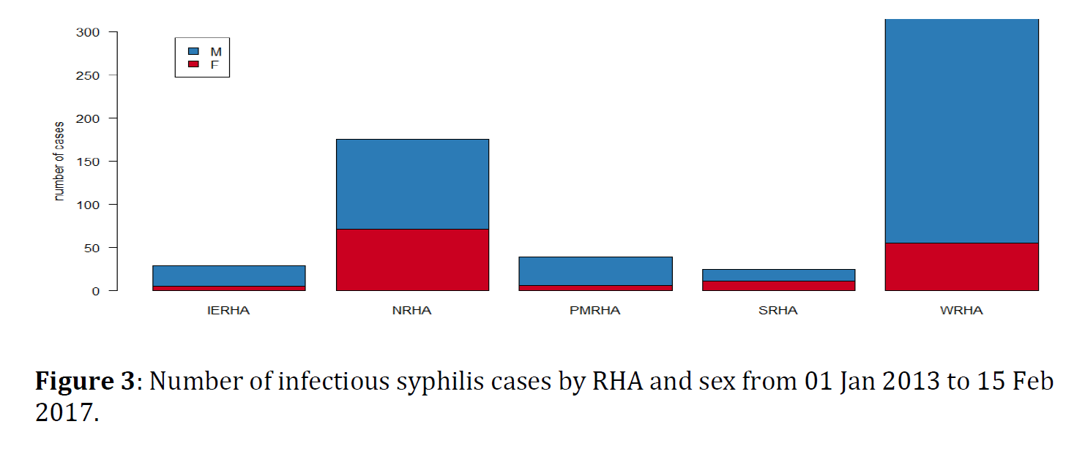
Infectious Syphilis – Rural Mb
epiUPDATE – syphilis (Manitoba Health) – March 2017

Slide 31
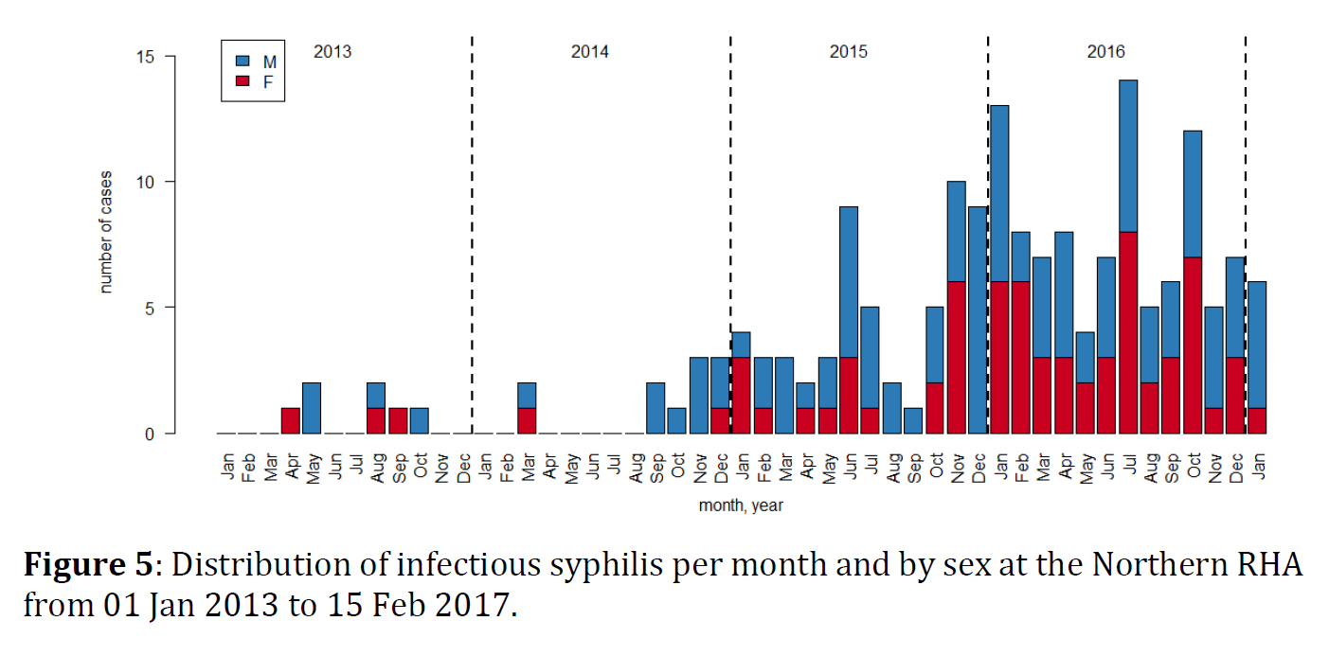
Infectious Syphilis – Rural Mb
epiUPDATE – syphilis (Manitoba Health) – March 2017

Slide 32
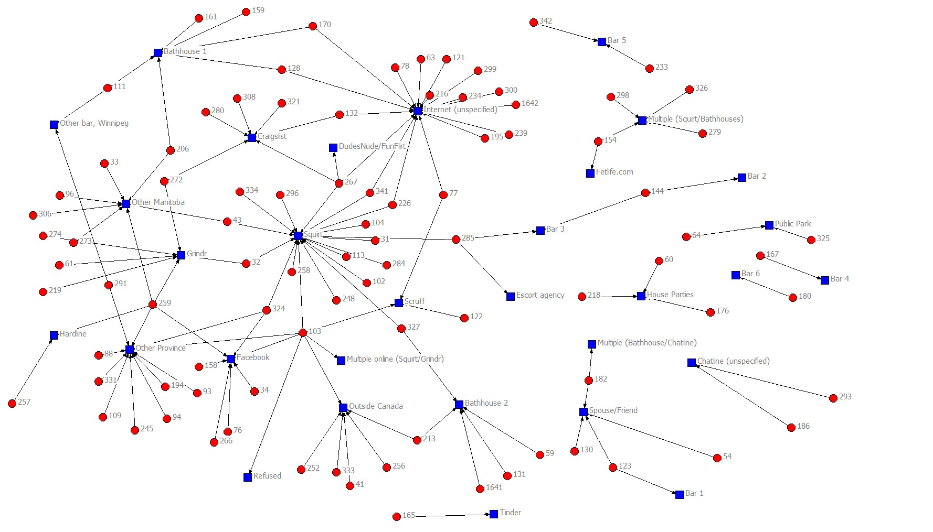
Network Diagram: Meeting Places
Notes:
Joss

Slide 33
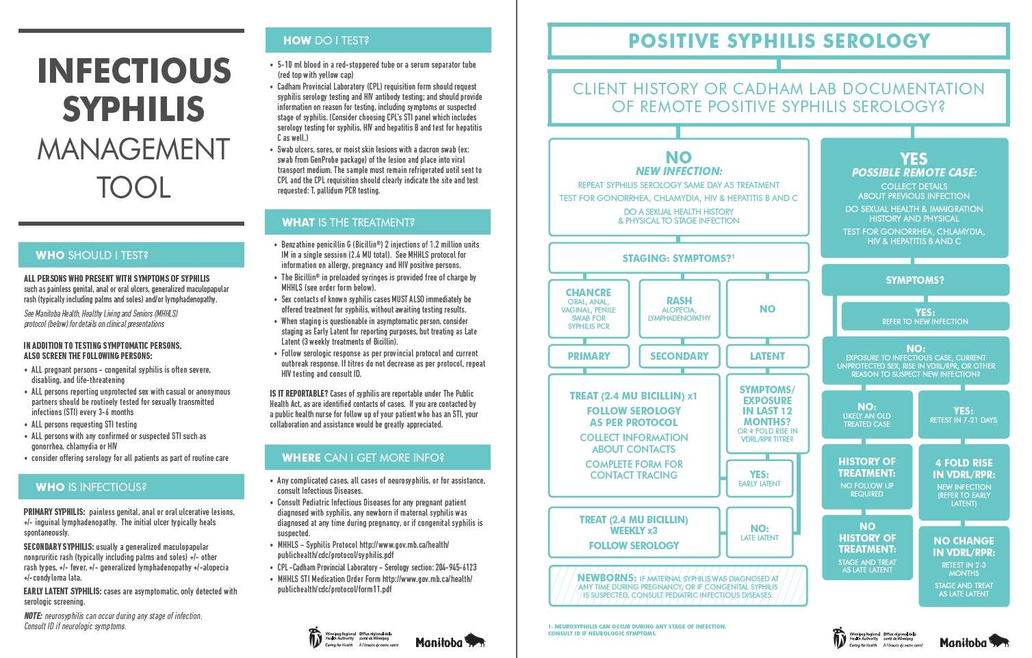
Outbreak Interventions
Health Care Provider Information
Notes:
Joss

Slide 34
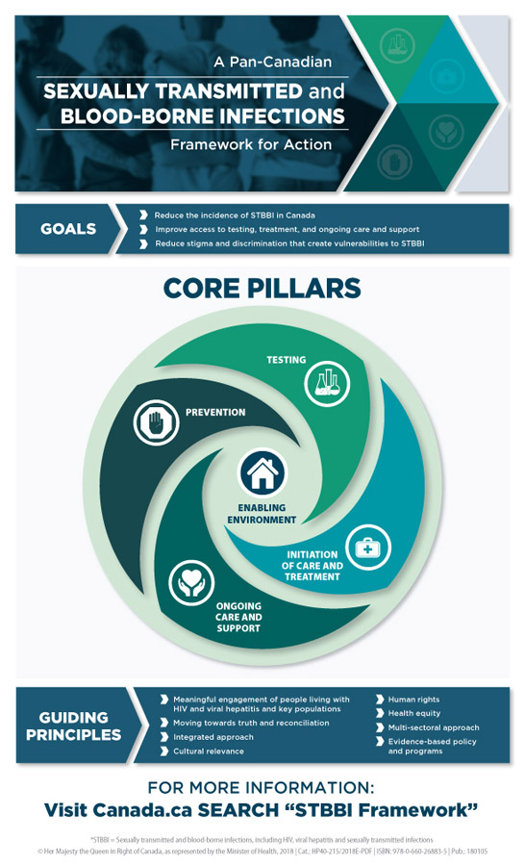
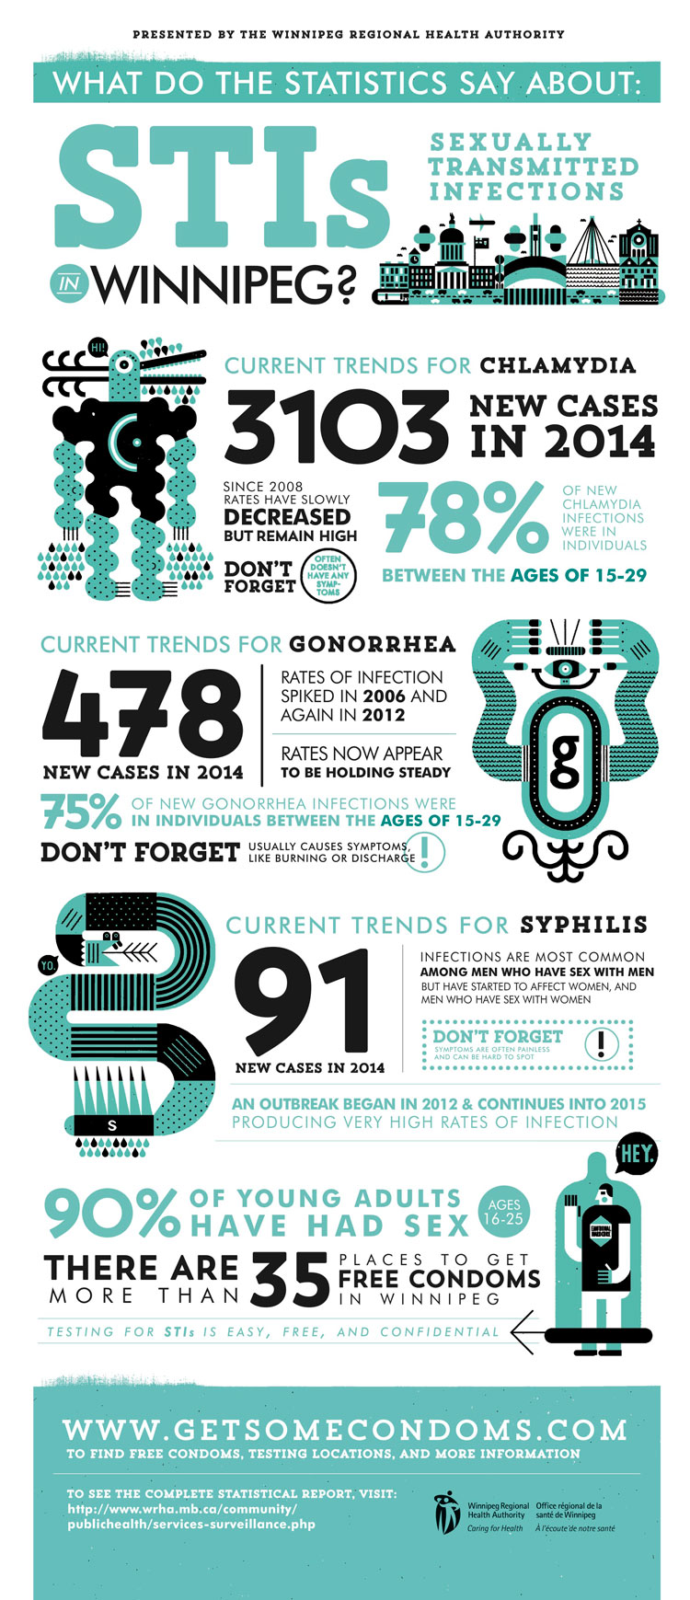

Slide 35
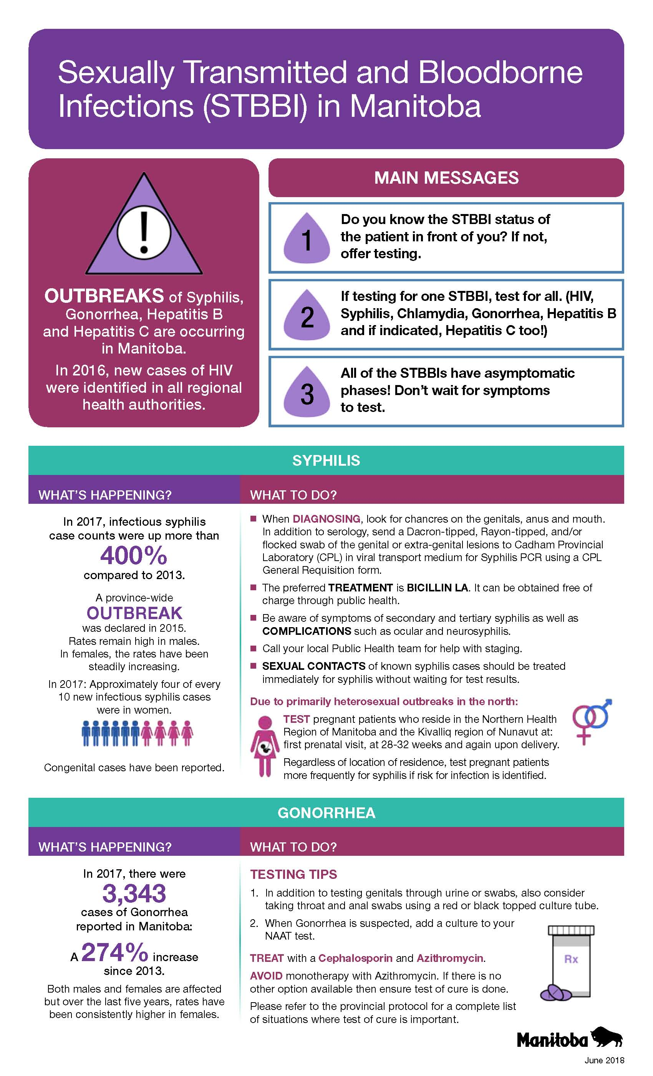
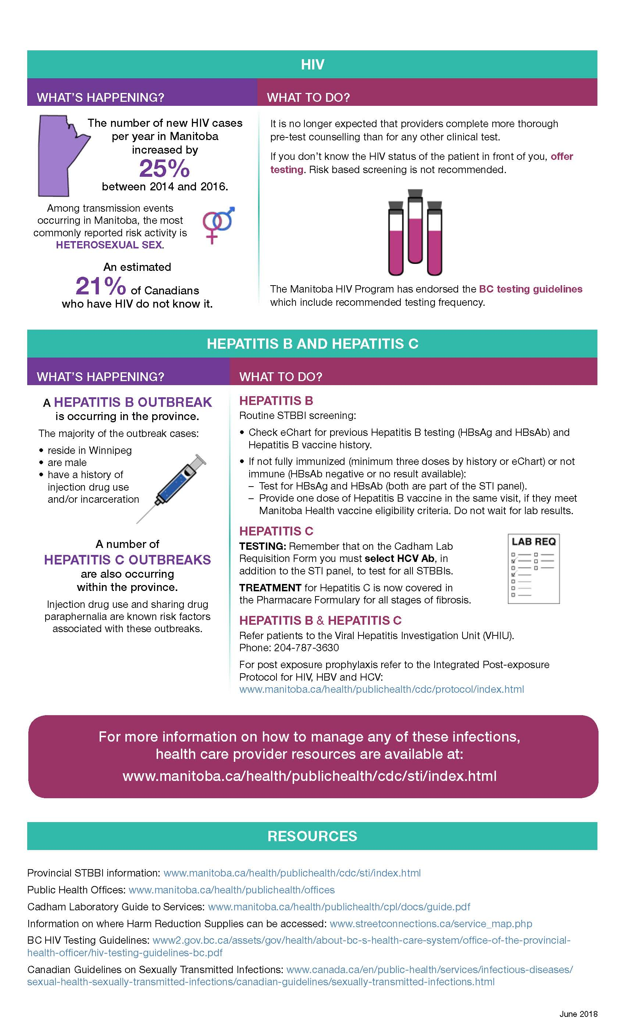

Slide 36
Outbreak Interventions
Assertive Testing Strategy (SasP)
Bathhouse Outreach
Case Management (TasP)
Social media advertising
Health Care Provider Information
Mapping (“frequent transmitters”)
Contact Notification (anonymity)
Notes:
NRHA – added enhanced pregnancy screening X3 (first visit, 28 weeks, delivery)
Assertive testing strategy - only 22% completed 3, 6, 9, and 12 months syphilis serology testing (very difficult to implement with limited resources)
- those refusing to get any repeat testing – 3 later found to have repeat syphilis infection (deemed late – delayed diagnosis)
- those participating in repeat testing – 20 repeat infections detected (10% of all infectious cases in 12 months); 2 new HIV infections detected early; phone/text/email reminders used by PHNs and primary care providers; much more positive interaction between PHNs and clients (phone reminders vs invasive contact investigation questions)

Slide 37
Assertive Testing Strategy
Offer q3mo syph testing to all previous syph cases (phone/text/email reminders)
Only 22% completed 3/6/9/12 mo testing
20 repeat syphilis infections detected (10% of all cases/12 mo; 2 new HIV)
Very positive PHN/client interaction
Future – focus on “core transmitting networks” = MSM/MSMW, <35 yo, past Hx STBBI (HIV), low income
Notes:
NRHA – added enhanced pregnancy screening X3 (first visit, 28 weeks, delivery)
Assertive testing strategy - offer routine q3monthly testing of all previously positive syphilis cases (focus on repeat infections)
- only 22% completed 3, 6, 9, and 12 months syphilis serology testing (very difficult to implement with limited resources)
- those refusing to get any repeat testing – 3 later found to have repeat syphilis infection (deemed late – delayed diagnosis)
- those participating in repeat testing – 20 repeat infections detected (10% of all infectious cases in 12 months); 2 new HIV infections detected early; phone/text/email reminders used by PHNs and primary care providers; much more positive interaction between PHNs and clients (phone reminders vs invasive contact investigation questions)
- future – focus on “core transmitting networks” associated with repeat syphilis = MSM/MSMW, <35 yo, past Hx STBBI (including HIV +), low income; facilitate testing options (pre-filled lab slips)

Slide 38
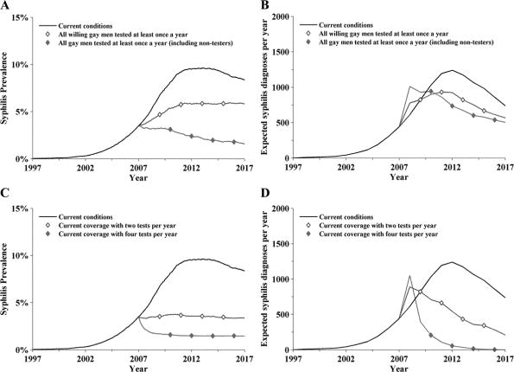
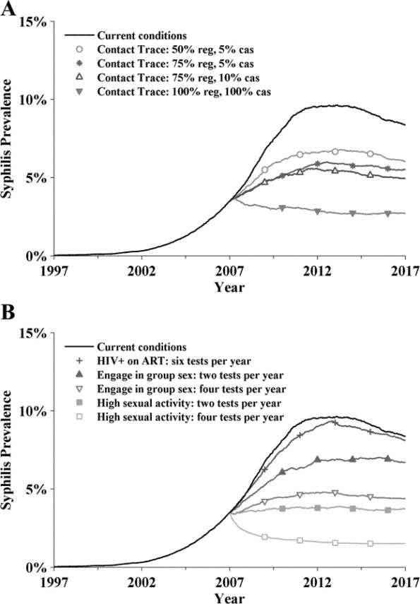
Frequent Testing of Highly Sexually Active Gay Men is Required to Control Syphilis (Sexually Transmitted Diseases. 2010;37(5):298-305)
Figure 1. The impact of increasing testing coverage to 100% over 10 years on (A) syphilis prevalence, and (B) annual syphilis diagnoses. The impact of increasing testing frequency over 10 years on (C) syphilis prevalence and (D) annual syphilis diagnoses.
Figure 2. Change in syphilis prevalence due to (A) contact tracing and treatment. B, Syphilis prevalence for the entire gay male population after increasing the testing frequency in particular population groups.
2

Slide 39
IP&C Considerations
Modes of syphilis transmission:
  Sexual (Most common) with a 9-64% risk of transmission¹
  Congenital – in utero or during passage in birth canal (less common)
  Blood products⁵ and organ donation (rare)
  Occupational²⁻⁴ and other exposures (rare)
https://www.ncbi.nlm.nih.gov/pubmed/9101629 (1997)
https://www.ncbi.nlm.nih.gov/pubmed/22431685 (2012 - scalpel)
https://www.ncbi.nlm.nih.gov/pubmed/8215748 (1993)
https://www.ncbi.nlm.nih.gov/pubmed/12978898 (1952)
https://www.ncbi.nlm.nih.gov/pubmed/20738828 (2010)

Slide 40
IP&C Considerations
Policy to have all higher risk pregnancies tested twice and a post-natal test
Direct contact with infected products – blood (rare), fetal materials, uterine secretions
Based on procedural risks – delivery (splash) vs elective surgery vs POCT (touch)
Standard precautions – confirmed infected fetal materials
Splash shield if risk of exposure to face/eyes – delivery
What is the true risk?
Stoltey JE, Cohen SE. Syphilis transmission: a review of the current evidence. Sex Health. 2015;12(2):103-9.

Slide 41
THE COST OF NOT PREVENTING A DISEASE
Estimate of Healthcare Costs for STBBIs based on Cases in MB in 2017
Disease | Chlamydia¹ | Gonorrhea² | Syphilis³ | HBV⁴ | HCV⁵ | HIV⁶
Cost/case | $ 113 | $ 200 | $ 433 | $ 2,954 | $ 63,461* | $ 16,846*
# Cases in 2017 | 7,273 | 3,343 | 242 | 57 | 611 | 108
Disease Costs | $ 821,482 | $ 668,600 | $ 104,786 | $ 168,378 | $ 38,774,671 | $ 1,819,368
Total Cost | $ 42,313,794
https://www.ncbi.nlm.nih.gov/pubmed/22421691
https://www.guttmacher.org/sites/default/files/pdfs/tables/360104/3601104t1.pdf
https://www.guttmacher.org/sites/default/files/pdfs/tables/360104/3601104t1.pdf
https://www.ncbi.nlm.nih.gov/pubmed/23368750
https://canadiantaskforce.ca/wp-content/uploads/2017/04/Wong-Model-PHAC-report-2016-Nov-22.pdf
http://www.cdnaids.ca/wp-content/uploads/Economic-Cost-of-HIV-AIDS-in-Canada.pdf
* These costs are estimated for the first year of medical therapy and direct health care costs
Notes:
Slide prepared by R.Rusk
Note from SL to R2: I think the Hep C numbers may be wrong/too high? Here is the source:
HEP C reference = “Burden of disease and cost of chronic hepatitis C infection in Canada. Myers, RC, et al. 2004” at https://www-ncbi-nlm-nih-gov.uml.idm.oclc.org/pmc/articles/PMC4049256/

Slide 42

Syphilis - Objectives
Review the clinical manifestations, diagnostic testing, and treatment of syphilis
Describe the evolving social epidemiology of syphilis in Manitoba
Discuss syphilis outbreak response strategies, and the significant challenges into the future
Address potential new IP&C risks

Slide 43
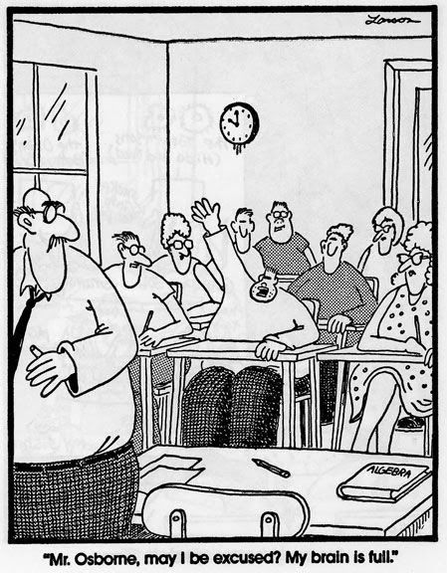
ANY MORE QUESTIONS?

